Slide 1
Chapter 6: Process Synchronization

Slide 2
Chapter Objectives 1/2
Describe the critical-section(临界区) problem and illustrate a race condition(竞争条件)
Illustrate hardware solutions to the critical-section problem using memory barriers(内存屏障), test-and-set operations, swap operations
Demonstrate how mutex locks(互斥锁), semaphores(信号量), monitors(管程), and condition variables(条件变量) can be used to solve the critical section problem
Explain the bounded-buffer(有界缓冲) synchronization problem(生产者-消费者问题)

Slide 3
Chapter Objectives 2/2
Explain the readers-writers synchronization problem(读者-写者问题)
Explain and dining-philosophers synchronization problems(哲学家就餐问题)
Describe the tools used by Linux and Windows to solve synchronization problems.
Illustrate how POSIX and Java can be used to solve process synchronization problems
To introduce the concept of atomic transaction(原子事务) and describe mechanisms to ensure atomicity.

Slide 4
Content Overview
Background
The Critical-Section Problem
Peterson’s Solution
Synchronization Hardware
Semaphores
Classic Problems of Synchronization
Monitors
Synchronization Examples
Atomic Transactions

Slide 5
6.1 Background
Concurrent access to shared data may result in data inconsistency
May be interrupted at any time, partially completing execution
Maintaining data consistency requires mechanisms to ensure the orderly execution of cooperating processes
Suppose that we wanted to provide a solution to the consumer-producer problem that fills all the buffers.
We can do so by having an integer count that keeps track of the number of full buffers. Initially, count is set to 0. It is incremented by the producer after it produces a new buffer and is decremented by the consumer after it consumes a buffer.
Notes:
第3章 进程 3.4.1小节中的生产者-消费者代码，使用in和out两个数组下标判断缓冲区空满，只能利用BUFFER_SIZE-1个缓冲区单元

Slide 6
Producer
while (true) {
// produce an item and put in nextProduced
while (count == BUFFER_SIZE)
; // do nothing
buffer [in] = nextProduced;
in = (in + 1) % BUFFER_SIZE;
count++; // Count = ?
}

Slide 7
Consumer
while (true) {
while (count == 0)
; // do nothing
nextConsumed = buffer[out];
out = (out + 1) % BUFFER_SIZE;
count--; // Count = ?
// consume the item in nextConsumed
}

Slide 8
Race Condition 1/2
count++ could be implemented as register1 = count register1 = register1 + 1 count = register1
count-- could be implemented as register2 = count register2 = register2 - 1 count = register2
Notes:
竞争条件，或竞态条件

Slide 9
Race Condition 2/2
Consider this execution interleaving with “count = 5” initially:
S0: producer execute register1 = count {register1 = 5} S1: producer execute register1 = register1 + 1 {register1 = 6} S2: consumer execute register2 = count {register2 = 5} S3: consumer execute register2 = register2 - 1 {register2 = 4} S4: producer execute count = register1 {count = 6 } S5: consumer execute count = register2 {count = 4}
Race condition: several processes access and manipulate the same data concurrently and the outcome of the execution depends on the particular order in which the access takes place. 中文称为：竞争条件，或竞态条件
Notes:
OS kernel中的next pid问题

Slide 10
6.2 The Critical-Section Problem
critical section, in which the process may be changing common variables, updating a table, writing a file, and so on.
entry section / exit section
while (true) {
entry section
critical section
exit section
remainder section
}
Notes:
临界区问题

Slide 11
Preemptive and Nonpreemptive Kernel
Preemptive kernel(抢占内核) allows a process in execution in the kernel mode to be interrupted by some other process
Nonpreemptive kernel(非抢占内核) does not allow a process in execution in the kernel mode to be interrupted by some other process. a kernel-mode process will run until it exits kernel mode, blocks, or voluntarily yields control of the CPU
It is harder to design preemptive kernels than nonpreemptive kernels
Preemptive kernel is more suitable for real-time programming than the nonpremptive kernel

Slide 12
Requirement to the Solutions
1. Mutual Exclusion(互斥) - If process P_{i} is executing in its critical section, then no other processes can be executing in their critical sections (waiting while busy)
2. Progress(有空让进) - If no process is executing in its critical section and there exist some processes that wish to enter their critical section, then the selection of the processes that will enter the critical section next cannot be postponed indefinitely (Let it in if empty)
3. Bounded Waiting(有限等待) - A bound must exist on the number of times that other processes are allowed to enter their critical sections after a process has made a request to enter its critical section and before that request is granted (limited waiting)
Assume that each process executes at a nonzero speed
No assumption concerning relative speed of the N processes

Slide 13
Initial Attempts to Solve Problem
Only 2 processes, P₀ and P₁
General structure of process P_{i} (other process P_{j})
repeat
entry section
critical section
exit section
reminder section
until false;
Processes may share some common variables to synchronize their actions.

Slide 14
Algorithm 1
Shared variables:
var turn: (0..1); initially turn = 0
turn - i ⇒ P_{i} can enter its critical section. i , j = 0, 1; j = 1 - i
Process P_{i} Process P_{j}
repeat repeat
while turn ≠ i do no-op; while turn ≠ j do no-op;
critical section critical section
turn := j; turn := i;
reminder section reminder section
until false; until false;
Satisfies mutual exclusion, but not progress
Notes:
OSC5有算法1。限制轮流进入

Slide 15
Algorithm 2
Shared variables
var flag: array [0..1] of boolean; initially flag [0] = flag [1] = false.
flag [i] = true ⇒ P_{i} ready to enter its critical section. i , j = 0, 1; j = 1 - i
Process P_{i} Process P_{j}
repeat repeat
flag[i] := true; flag[j] := true; while flag[j] do no-op; while flag[i] do no-op;
critical section critical section
flag [i] := false; flag [j] := false;
remainder section remainder section
until false; until false;
Satisfies mutual exclusion, but not progress requirement.
Notes:
OSC5有算法2。有可能死锁。两个进程的flag都设置为true，互相忙等待，无法推进

Slide 16
6.3 Peterson’s Solution
Two process solution
Assume that the load and store machine-language instructions are atomic; that is, cannot be interrupted
The two processes share two variables:
int turn;
boolean flag[2]
The variable turn indicates whose turn it is to enter the critical section
The flag array is used to indicate if a process is ready to enter the critical section.
flag[i] = true implies that process P_{i} is ready!
Notes:
Peterson 1981年，仅可用于2个进程。第一个正确解决2个进程临界区问题的软件方法，是由Dekker设计的，详见OSC7习题6.1

Slide 17
Algorithm for Process P_{i}
while (true) {
flag[i] = true;
turn = j;
while (flag[j] && turn == j)
;
/* critical section */
flag[i] = false;
/* remainder section */
}
Must in order!
Notes:
我想进，轮到你；若你想进，且轮到你，那么我就再等等

Slide 18
Peterson’s Solution P_{i} & P_{j}
while (true) {
flag[i] = true;
turn = j;
while(flag[j] && turn == j)
;
/* critical section */
flag[i] = false;
/* remainder section */
}
while (true) {
flag[j] = true;
turn = i;
while(flag[i] && turn == i)
;
/* critical section */
flag[j] = false;
/* remainder section */
}
我想进，轮到你；若你想进，且轮到你，那么我就再等等

Slide 19
Correctness of Peterson’s Solution
Provable that the three CS requirement are met:
1. Mutual exclusion is preserved
P_{i} enters CS only if:
either flag[j] = false or turn = i
2. Progress requirement is satisfied
3. Bounded-waiting requirement is met

Slide 20
Example Executing Sequence of P_{i} & P_{j}
while (true) {
flag[i] = true;
turn = j;
while(flag[j] && turn == j)
;
/* critical section */
flag[i] = false;
/* remainder section */
}
while (true) {
flag[j] = true;
turn = i;
while(flag[i] && turn == i)
;
/* critical section */
flag[j] = false;
/* remainder section */
}
1
2
6
3
4
5,9
7
8
?
10
11
?
我想进，轮到你；若你想进，且轮到你，那么我就再等等

Slide 21
Example Executing Sequence of P_{i} & P_{j}
while (true) {
flag[i] = true;
turn = j;
while(flag[j] && turn == j)
;
/* critical section */
flag[i] = false;
/* remainder section */
}
while (true) {
flag[j] = true;
turn = i;
while(flag[i] && turn == i)
;
/* critical section */
flag[j] = false;
/* remainder section */
}
1
5
6,10
2
3
4,7
11
12
?
8
9
?
我想进，轮到你；若你想进，且轮到你，那么我就再等等

Slide 22
Incorrect Coding of Peterson’s Solution
while (true) {
turn = j;
flag[i] = true;
while (flag[j] && turn == j)
;
/* critical section */
flag[i] = false;
/* remainder section */
}
Wrong order!
Consider such running sequence：
Pi: turn = j
Pj: turn = i
Pj: flag[j] = true
Pj: while(flag[i] && turn == i) ;
Pj: enter CS
Pi: flag[i] = true
Pi: while(flag[j] && turn == j) ;
Pi: enter CS too！
Notes:
即使我们的编码顺序正确，为了执行的效率，现代的编译器或CPU的指令执行，也有可能与源码顺序不一致

Slide 23
*Peterson’s Solution and Modern Architecture
Although useful for demonstrating an algorithm, Peterson’s Solution is not guaranteed to work on modern architectures.
To improve performance, processors and/or compilers may reorder operations that have no dependencies
Understanding why it will not work is useful for better understanding race conditions.
For single-threaded this is ok as the result will always be the same.
For multithreaded the reordering may produce inconsistent or unexpected results!

Slide 24
*Modern Architecture Example
Two threads share the data: boolean flag = false; int x = 0;
Thread 1 performs while (!flag) ; print x;
Thread 2 performs x = 100; flag = true;
What is the expected output?
100

Slide 25
*Modern Architecture Example (Cont.)
However, since the variables flag and x are independent of each other, the instructions:
x = 100;
flag = true;
for Thread 2 may be reordered:
flag = true; x = 100;
If this occurs, the output may be 0!

Slide 26
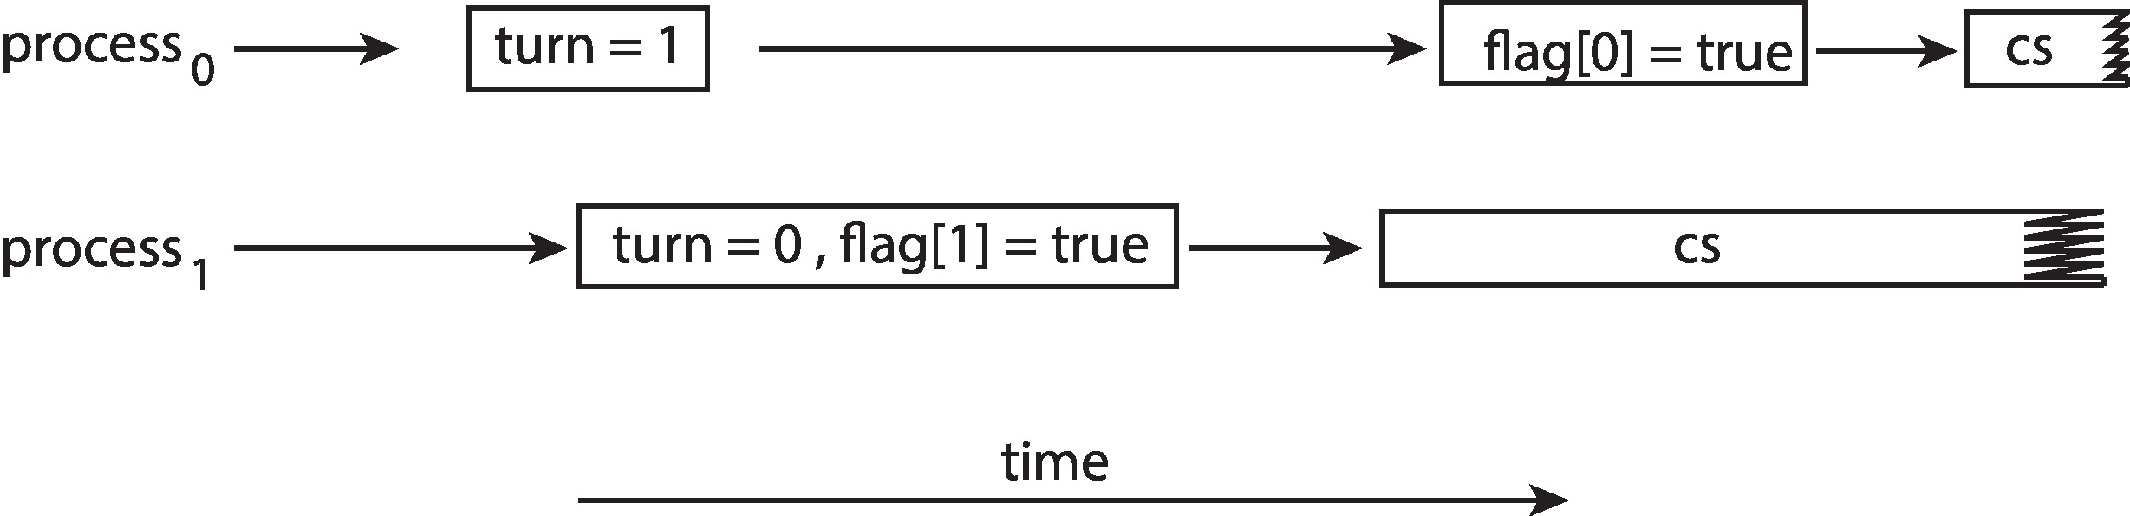
*Peterson’s Solution Revisited
The effects of instruction reordering in Peterson’s Solution
This allows both processes to be in their critical section at the same time!
To ensure that Peterson’s solution will work correctly on modern computer architecture we must use Memory Barrier(内存屏障).

Slide 27
*Memory Barrier(内存屏障)
Memory model are the memory guarantees a computer architecture makes to application programs.
Memory models may be either:
Strongly ordered – where a memory modification of one processor is immediately visible to all other processors.
Weakly ordered – where a memory modification of one processor may not be immediately visible to all other processors.
A memory barrier is an instruction that forces any change in memory to be propagated (made visible) to all other processors.

Slide 28
*Memory Barrier Instructions
When a memory barrier instruction is performed, the system ensures that all loads and stores are completed before any subsequent load or store operations are performed.
Therefore, even if instructions were reordered, the memory barrier ensures that the store operations are completed in memory and visible to other processors before future load or store operations are performed.

Slide 29
*Memory Barrier Example
Returning to the example of slides ch6-22 & ch6-23
We could add a memory barrier to the following instructions to ensure Thread 1 outputs 100:
Thread 1 now performs while (!flag) memory_barrier(); print x
Thread 2 now performs x = 100; memory_barrier(); flag = true
For Thread 1 we are guaranteed that that the value of flag is loaded before the value of x.
For Thread 2 we ensure that the assignment to x occurs before the assignment flag.

Slide 30
6.4 Synchronization Hardware
Many systems provide hardware support for critical section code
Uniprocessors – could disable interrupts
Currently running code would execute without preemption
Generally too inefficient on multiprocessor systems
Operating systems using this not broadly scalable
Modern machines provide special atomic hardware instructions
Atomic = non-interruptable
Either test memory word and set value
Or swap contents of two memory words

Slide 31
The TestAndSet Instruction
Definition
boolean TestAndSet(boolean *target)
{
boolean rv = *target;
*target = TRUE;
return rv:
}
Properties
Executed atomically
Returns the original value of passed parameter
Set the new value of passed parameter to TRUE
这仅仅是TestAndSet机器指令的功能描述，而非TestAndSet是用这样的函数实现的
Notes:
这仅仅是TestAndSet机器指令的功能描述，而非TestAndSet是用这样的函数实现的

Slide 32
Solution Using TestAndSet
Shared boolean variable lock, initialized to FALSE
Solution:
do { while(TestAndSet(&lock))
; /* do nothing */
/* critical section */
lock = FALSE;
/* remainder section */
} while(TRUE);
Does it solve the critical-section problem?
Notes:
满足了互斥及有空让进，但没有解决有限等待要求

Slide 33
The Swap Instruction
Definition
void Swap(boolean *a, Boolean *b)
{
boolean temp = *a;
*a = *b;
*b = temp;
}
Properties
Swap two values atomically
这仅仅是Swap机器指令的功能描述，而非Swap是用这样的函数实现的
Notes:
这仅仅是Swap机器指令的功能描述，而非Swap是用这样的函数实现的

Slide 34
Solution Using Swap
Shared Boolean variable lock initialized to FALSE; Each process has a local Boolean variable key.
Solution:
while (true) {
key = TRUE;
while ( key == TRUE)
Swap (&lock, &key ) ;
// critical section
lock = FALSE;
// remainder section
}
Does it solve the critical-section problem?
Notes:
满足了互斥及有空让进，但没有解决有限等待要求

Slide 35
Bounded-Waiting Mutual Exclusion with TestAndSet
n个进程，组成一个单向环。在锁为空时，首个申请的进程得到锁；在锁忙时，所有等待的进程，按在环中的位置顺序得到锁
waiting[n]及lock为n个进程共享的变量，初值均为false
waiting[i]为true表示进程i正在申请锁，但尚未得到
lock为false表示无进程得到锁，为true表示已有进程得到了锁
key为各进程的局部bool变量，用于获得锁的状态，true表示已有其他进程得到了锁
i，j为各进程的局部int变量。i代表自己，j用于寻找环中下一个申请锁的进程

Slide 36
bool waiting[n]; // Shared var, all initialized to false
bool lock = false; // Shared var
do {
waiting[i] = true; // Want to acquire the lock
key = true;
while (waiting[i] && key) // I need, but not acquired
key = TestAndSet(&lock);
waiting[i] = false; // Lock acquired
/* critical section */
j = (i + 1) % n; // Circular serach from i + 1 process
while ((j != i) && !waiting[j]) // Finish searching or find one?
j = (j + 1) % n; // No, search next process
if (j == i) // No other process’s claim
lock = false; // Just release the lock
else // Process j has claimed
waiting[j] = false; // Let process j get the lock directly
/* remainder section */
} while(true);
j
6
5
7
4
0
3
1
2
i
Notes:
OSC7 Fig. 6.8

Slide 37
Mutex Locks(互斥锁)
Previous solutions are complicated and generally inaccessible to application programmers
OS designers build software tools to solve critical section problem
Simplest is mutex(mutual exclusion ) lock
Boolean variable indicating if lock is available or not
Protect a critical section by
First acquire() a lock
Then release() the lock
Calls to acquire() and release() must be atomic(原子操作)
Usually implemented via hardware atomic instructions such as test-and-set or swap.
But this solution requires busy waiting(忙等待)
This lock therefore called a spinlock(自旋锁)
Notes:
Mutex: mutual exclusive

Slide 38
Solution to CS Problem Using Mutex Locks
while (true) {
acquire lock
critical section
release lock
remainder section
}

Slide 39
6.5 Semaphore(信号量)
Synchronization tool that provides more sophisticated ways (than Mutex locks) for processes to synchronize their activities.
Semaphore S – integer variable
Can only be accessed via two indivisible (atomic) operations
wait() and signal()
Originally called P() and V()
Notes:
P/V来自荷兰语

Slide 40
信号量(Semaphore)机制
荷兰学者Edsger Dijkstra(迪杰斯特拉)，1965年提出
semaphore ['seməfɔ:]
vi. 打旗语；发信号
n. 信号；旗语；臂板信号机
vt. 用信号联络
P()/V()分别来自荷兰语proberen(to test)，及verhogen(to increment)的首字母

Slide 41
Semaphore (Cont.)
wait(S) {
while (S <= 0)
; // busy wait
S--;
}
signal(S) {
S++;
}
Notes:
wait操作先检查S，再--，因此S值恒为非负

Slide 42
Semaphore (Cont.)
Counting semaphore – integer value can range over an unrestricted domain
Binary semaphore – integer value can range only between 0 and 1
Same as a mutex lock
Can implement a counting semaphore S as a binary semaphore(在没有提供互斥锁的系统上，可以使用二进制信号量来提供互斥)
With semaphores we can solve various synchronization problems

Slide 43
Semaphore Usage Example
Solution to the CS Problem
Create a semaphore “mutex” initialized to 1
wait(mutex);
CS
signal(mutex);
Consider P₁ and P₂ that with two statements S₁ and S₂ and the requirement that S₁ to happen before S₂
Create a semaphore “synch” initialized to 0
P1:
S₁;
signal(synch);
P2:
wait(synch);
S₂;

Slide 44
Semaphore Implementation
Must guarantee that no two processes can execute the wait() and signal() on the same semaphore at the same time
Thus, the implementation becomes the critical section problem where the wait and signal code are placed in the critical section
Could now have busy waiting in critical section implementation
But implementation code is short
Little busy waiting if critical section rarely occupied
Note that applications may spend lots of time in critical sections and therefore this is not a good solution

Slide 45
Semaphore Implementation with no Busy waiting
With each semaphore there is an associated waiting queue
Each entry in a waiting queue has two data items:
Value (of type integer)
Pointer to next record in the list
Two operations:
block – place the process invoking the operation on the appropriate waiting queue
wakeup – remove one of processes in the waiting queue and place it in the ready queue

Slide 46
Implementation with no Busy waiting (Cont.)
Waiting queue
typedef struct {
int value;
struct process *list;
} semaphore;

Slide 47
wait(semaphore *S) {
S->value--;
if (S->value < 0) { add this process to S->list;
block();
}
}
signal(semaphore *S) {
S->value++;
if (S->value <= 0) { remove a process P from S->list;
wakeup(P);
}
}
Notes:
注意这里无忙等待的wait，是先将value--，再判断value值的。Signal中的进程P是从list中选出来的另一个进程，而非调用signal的进程

Slide 48
Implementation with no Busy waiting (Cont.)
在无忙等待的wait及signal实现中，信号量S值的含义：
S > 0：S的值为当前资源数目
S < 0：S的绝对值为在等待队列中等待资源的进程数目
S = 0：当前没有资源可用，也没有等待资源的进程
对于进程互斥问题，通常wait与signal在同一个进程中
对于进程同步问题，通常wait与signal在不同的进程中
对wait与signal的调用必须总体上数量平衡(指代码的动态执行次数是平衡的，而非源码中)
对于2个不同的信号量的连续操作，通常同步操作在前，互斥操作在后(见后面的生产者消费者问题)
信号量S值的初值通常 >= 0

Slide 49
Problems with Semaphores
Incorrect use of semaphore operations(in source code):
signal(mutex) … wait(mutex)
wait(mutex) … wait(mutex)
Omitting of wait(mutex) and/or signal(mutex)
These – and others – are examples of what can occur when semaphores and other synchronization tools are used incorrectly.

Slide 50
Deadlock and Starvation
Deadlock(死锁) – two or more processes are waiting indefinitely for an event that can be caused by only one of the waiting processes
Let S and Q be two semaphores initialized to 1
P₀ P₁
wait (S); wait (Q);
wait (Q); wait (S);
. .
. .
. .
signal (S); signal (Q);
signal (Q); signal (S);
Starvation(饥饿) – indefinite blocking. A process may never be removed from the semaphore queue in which it is suspended.
Notes:
当仅有一个进程活动时，没有问题。但当P0先执行wait(S)后，紧接着切换为P1再执行wait(Q)，双方各持一把互斥锁S与Q，无法再推进，死锁

Slide 51
6.6 Classical Problems of Synchronization
Bounded-Buffer Problem
Readers and Writers Problem
Dining-Philosophers Problem

Slide 52
Bounded-Buffer Problem
n buffers, each can hold one item
Semaphore mutex initialized to the value 1
Semaphore full initialized to the value 0
Semaphore empty initialized to the value n
producer
consumer
Notes:
有界缓冲问题，又称为生产者-消费者问题。可以是多个生产者，多个消费者

Slide 53
Bounded Buffer Problem (Cont.)
The structure of the producer process
while (true) {
// produce an item
wait (empty);
wait (mutex);
// add the item to the buffer
signal (mutex);
signal (full);
}
Must in order!

Slide 54
Bounded Buffer Problem (Cont.)
The structure of the consumer process
while (true) {
wait (full);
wait (mutex);
// remove an item from buffer
signal (mutex);
signal (empty);
// consume the removed item
}
Must in order!

Slide 55
Bounded Buffer Problem (Cont.)
Incorrect coding of the consumer process
while (true) {
wait (mutex);
wait (full);
// remove an item from buffer
signal (mutex);
signal (empty);
// consume the removed item
}
Wrong order!
Notes:
在缓冲区全空，生产者也没在生产时：消费者先获得mutex，并阻塞在wait(full)；生产者此时无法取得mutex，也就无法更新full值，死锁

Slide 56
Bounded Buffer Problem (Cont.)
在前页不正确的消费者实现代码中：
在缓冲区全空(full为0)，生产者也没在生产时，消费者先获得mutex，继而阻塞在wait(full)处
而生产者在此时之后因无法取得mutex，阻塞在wait(mutex)处，也就无法生产来更新full值
生产者与消费者发生死锁！
很容易分析出，在生产者的代码中，两个wait语句也有顺序要求

Slide 57
Bounded Buffer Problem (Cont.)
注意到在前述producer/consumer的代码中，full与empty呈现了一种跨进程的对称关系
这是因为producer与consumer的角色，实际上就是对称的：
生产者生产满的buffer单元，消费者消费满的buffer单元
消费者生产空的buffer单元，生产者消费空的buffer单元
这种情况下的对称特性，可帮助我们检查代码是否存在问题：待解决的问题呈现对称性，实现的代码也应该有某种对称性
注：前述producer/consumer实现中，允许多个producer/consumer存在

Slide 58
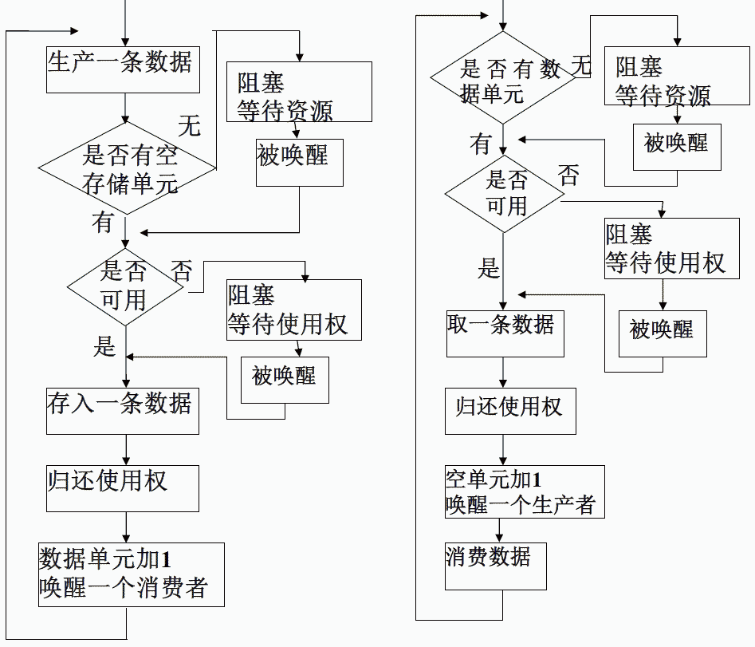
生产者-消费者执行流程图
生产者
消费者

Slide 59
Readers-Writers Problem
A data set is shared among a number of concurrent processes
Readers – only read the data set; they do not perform any updates
Writers – can both read and write
Problem – allow multiple readers to read at the same time
Only one single writer can access the shared data at the same time
Several variations of how readers and writers are considered – all involve some form of priorities
Notes:
读者-写者问题

Slide 60
Illustration of Readers-Writers Problem
Readers Writers
将读者-写者分成两个门进出，仅为叙述问题直观方便，并没有给原问题增加任何新的约束条件

Slide 61
Readers-Writers Problem (Cont.)
Shared Data
Data set
Integer readcount initialized to 0
Semaphore mutex initialized to 1
Semaphore wrt initialized to 1
Method:
Readers First / Writers First / Fair
The structure of a writer process
while (true) {
wait (wrt) ; // 写者把读者侧的门从内部锁上
// writing is performed
signal (wrt) ; // 写者把读者侧的门从内部打开
}
信号量wrt为读者和写者进程共用。
信号量mutex用于确保在更新readcount时的互斥。
Readcount用来跟踪多少个进程正在读
Notes:
此为读者优先实现

Slide 62
Readers-Writers Problem (Cont.)
The structure of a reader process
while (true) {
wait (mutex);
readcount++;
if (readcount == 1) wait (wrt); // 第1个读者把写者侧的门从内部锁上
signal (mutex)
// reading is performed
wait (mutex);
readcount--;
if (readcount == 0) signal (wrt); //最后1个读者把写者侧的门从内部打开
signal (mutex);
}
Writers Starvation?!
Notes:
此为读者优先实现

Slide 63
Readers-Writers Problem Variations
The solution in previous slides can result in a situation where a writer process never writes. It is referred to as the “First reader-writer” problem.
The “Second reader-writer” problem is a variation the first reader-writer problem that state:
Once a writer is ready to write, no “newly arrived reader” is allowed to read.
Both the first and second may result in starvation. Leading to even more variations
Problem is solved on some systems by kernel providing reader-writer locks

Slide 64
写者优先
int Rcount=0; //“正在读”的进程数，初值是0
int Wcount=0; //“等待写”的进程数，初值是0
semaphore r=1; //信号量，用于Rcount的互斥
semaphore w=1; //信号量，用于Wcount的互斥
semaphore RWmutex=1; //信号量，用于读者写者互斥
semaphore Wmutex=1; //信号量，用于写者互斥
**writer**
.
.
.
P(w);
Wcount++;
if(Wcount ==1) //第一个等待写者进入时
P(RWmutex); //申请读写资源
V(w);
P(Wmutex);
writing;
V(Wmutex);
P(w);
Wcount--;
If(Wcount == 0)
V(RWmutex); //无等待写者则写者释放
V(w); //读写资源
**Reader**
P(w); //如果有写者在等待RWmutex，那么它肯
定占有w，于是读者在这里会阻塞
V(w); //立即释放掉，使写者随时可申请到w
P(r);
Rcount++;
if(Rcount == 1) //第一个读者进入时，
P(RWmutex); //如已有写者，其会被阻塞
V(r);
reading;
P(r);
Rcount--;
If(Rcount==0)
V(RWmutex);
V(r);
Notes:
William Stallings的《操作系统-精髓与设计原理》中，给出了一个略微不同的写者优先的reader代码

Slide 65
写者优先
int Rcount=0; //“正在读”的进程数，初值是0
int Wcount=0; //“等待写”的进程数，初值是0
semaphore r=1; //信号量，用于Rcount的互斥
semaphore w=1; //信号量，用于Wcount的互斥
semaphore RWmutex=1; //信号量，用于读者写者互斥
semaphore Wmutex=1; //信号量，用于写者互斥
Reader1
Writer1
Reader2
**writer**
.
.
.
P(w);
Wcount++;
if(Wcount ==1) //第一个等待写者进入时
P(RWmutex); //申请读写资源
V(w);
P(Wmutex);
writing; // Writer1 先于 reader2 执行
V(Wmutex);
P(w);
Wcount--;
If(Wcount == 0)
V(RWmutex); //无等待写者则写者释放
V(w); //读写资源
**Reader**
P(w); //如果有写者在等待RWmutex，那么它肯
定占有w，于是读者在这里会阻塞
V(w); //立即释放掉，使写者随时可申请到w
P(r);
Rcount++;
if(Rcount == 1) //第一个读者进入时，
P(RWmutex); //如已有写者，其会被阻塞
V(r);
reading;
P(r);
Rcount--;
If(Rcount==0)
V(RWmutex);
V(r);
1 13
2 20*
3 21
4 22
5 23
6 24
7 33*
8 34
14 35
15 36
16 37
17 38
18* 39
9
10
11
12
19*
25*
26
27
28
29
30
31
32*

Slide 66
写者优先
int Rcount=0; //“正在读”的进程数，初值是0
int Wcount=0; //“等待写”的进程数，初值是0
semaphore r=1; //信号量，用于Rcount的互斥
semaphore w=1; //信号量，用于Wcount的互斥
semaphore RWmutex=1; //信号量，用于读者写者互斥
semaphore Wmutex=1; //信号量，用于写者互斥
Writer1
Reader1
Writer2
**writer**
.
.
.
P(w);
Wcount++;
if(Wcount ==1) //第一个等待写者进入时
P(RWmutex); //申请读写资源
V(w);
P(Wmutex);
writing; // Writer2 插队成功！
V(Wmutex);
P(w);
Wcount--;
If(Wcount == 0)
V(RWmutex); //无等待写者则写者释放
V(w); //读写资源
**Reader**
P(w); //如果有写者在等待RWmutex，那么它肯
定占有w，于是读者在这里会阻塞
V(w); //立即释放掉，使写者随时可申请到w
P(r);
Rcount++;
if(Rcount == 1) //第一个读者进入时，
P(RWmutex); //如已有写者，其会被阻塞
V(r);
reading;
P(r);
Rcount--;
If(Rcount==0)
V(RWmutex);
V(r);
8
9
10
11
12
13
31*
32
33
34
35
36
37
1 14
2 15
3 16
4
5 17
6 18
7 24*
19 25
20* 26
21 27
22 28
29
23 30*

Slide 67

Dining-Philosophers Problem
N philosophers’ sit at a round table with a bowel of rice in the middle
They spend their lives alternating thinking and eating
They do not interact with their neighbors
Occasionally try to pick up 2 chopsticks (one at a time) to eat from bowl
Need both to eat, then release both when done
In the case of 5 philosophers, the shared data
Bowl of rice (data set)
Semaphore chopstick [5] initialized to 1
3
2
3
4
2
4
1
0
1
0
Notes:
哲学家就餐问题。逆时针编号

Slide 68
Dining-Philosophers Problem Algorithm
Semaphore Solution
The structure of Philosopher i :
while (true){
wait (chopstick[i] );
wait (chopStick[ (i + 1) % 5] );
/* eat for awhile */
signal (chopstick[i] );
signal (chopstick[ (i + 1) % 5] );
/* think for awhile */
}
What is the problem with this algorithm? Deadlock? Starvation?

Slide 69
Poor Solution
N = 5 # Number of philosophers
eat_sem = new_semaphore(1) # Controls access to eating
def philosopher():
repeat_forever:
think()
P(eat_sem) # Enter critical section
take_chopstick(i) # Pick up left chopstick
take_chopstick((i+1) % N) # Pick up right chopstick
eat() # Shovel it in
put_chopstick((i+1) % N) # Put down right chopstick
put_chopstick(i) # Put down left chopstick
V(eat_sem) # Leave critical section
Notes:
仅允许1个哲学家同时就餐。无死锁，但可能饥饿

Slide 70
Good Solution 1
semaphore c[5]; // 5只筷子的信号量，初值均为1
philosopher(int i) { // 哲学家编号 0-4
if((i % 2) == 0) { // 偶数号哲学家
P(c[i]); // 先拿左边的筷子
P(c[(i + 1) % 5]); // 后拿右边的筷子
Eating();
V(c[i]); // 放下左边的筷子
V(c[(i + 1) % 5]); // 放下右边的筷子
}
else { // 奇数号哲学家
P(c[(i + 1) % 5]); // 先拿右边的筷子
P(c[i]); // 后拿左边的筷子
Eating();
V(c[(i + 1) % 5]); // 放下右边的筷子
V(c[i]); // 放下左边的筷子
}
}
Any other Solution?
Restrain only 4 can pickup chopsticks?

Slide 71
Good Solution 2
N = 5 # Number of philosophers
THINKING = 0 # Philosopher is thinking
HUNGRY = 1 # Philosopher is trying to get chopsticks
EATING = 2 # Philosopher is eating
for i = 0 to N-1:
state[i] = THINKING # Philosophers are thinking at start
phil_sem[i] = new_semaphore(0) # One semaphore per philosopher
chop_sem = new_semaphore(1) # Someone getting/dropping chopsticks
def left(i): return (i + N - 1) % N # Determine number of left neighbour
def right(i): return (i + 1) % N # Determine number of right neighbour
def philosopher(i):
repeat_forever:
think() # Thinking for a while
take_chopsticks(i) # Acquire both chopsticks, or block
eat() # Shovel it in
put_chopsticks(i) # Happiness: put both chopsticks down

Slide 72
def take_chopsticks(i):
P(chop_sem) # Want exclusive on chopsticks
state[i] = HUNGRY # Philosopher wants to eat
test(i) # Check if can pick uo both chopsticks
V(chop_sem) # Release exclusive on chopsticks
P(phil_sem[i]) # Proceed, or block waiting for chops
def put_chopsticks(i):
P(chop_sem) # Want exclusive on chopsticks
state[i] = THINKING # Philosopher has finished eating
test(left(i)) # Left neighbour may unblock/eat
test(right(i)) # Right neighbour may unblock/eat
V(chop_sem) # Release exclusive on chopsticks
def test(i):
neighbours_ok = state[left(i)] != EATING && state[right(i)] != EATING
if state[i] == HUNGRY && neighbours_ok:
state[i] = EATING # Time for this philosopher to eat
V(phil_sem[i]) # Must happen before phil[i] can eat

Slide 73
两种物品的仓库问题
设有一个可以装A、B两种物品的仓库，其容量无限大，但要求仓库中A、B两种物品的数量满足下述不等式：-M <= (A物品数量 - B物品数量) <= N，其中M和N为正整数。试用信号量和PV操作描述A、B两种物品的入库过程
semaphore mutex = 1, sem_a = N, sem_b = M;
proc_a() {
while(true) {
P(sem_a);
P(mutex);
A产品入库;
V(mutex);
V(sem_b);
}
}
proc_b() {
while(true) {
P(sem_b);
P(mutex);
B产品入库;
V(mutex);
V(sem_a);
}
}

Slide 74
两种物品的仓库问题再思考
不等式：-M <= A物品数量 – B物品数量 <= N，等效为同时满足下列2个不等式：
A – B <= N 与 B – A <= M
注意到A、B的绝对大小不重要，重要的是他们之间的差值。因此可把A、B同时减去同一个值：
(A – min(A, B)) – (B – min(A, B)) <= N
(B – min(A, B)) – (A – min(A, B)) <= M
此问题等效为仓库门口内侧有单元数各为N、M的，用于暂存A、B物品的缓冲区，一旦A、B物品同时在缓冲区出现，立即(速度无限快)成对地送入仓库深处
蓝绿2项，至少有一项为0
a
0
1
2
N-1
a & b
b
0
1
2
M-1
蓝绿2个缓冲区，至少有一个为空。
A、B之间，互为生产者、消费者；
此问题为变形的生产者、消费者问题

Slide 75
两种部件的产品组装问题 1/2
一件产品c由一个部件a与一个部件b组装而成。输入a部件的流水线最多存放N件a部件，输入b部件的流水线最多存放M件b部件，组装工位c可以容纳正在组装中的a、b两种部件各一件。请用信号量和PV操作，写出输入a及b部件的流水线，以及组装产品c的过程。
与前述“两种物品的仓库问题”相比，该问题更接近于经典的生产者-消费者问题。a与b均为生产者，c为消费者
也可以把前述“两种物品的仓库问题”，想象成有一个隐含的快速组装过程。该过程自动检查A/B流水线是否均为非空。且该组装过程速度无限快，无需同步，也不堵塞
a
0
1
2
N-1
c
b
0
1
2
M-1

Slide 76
两种部件的产品组装问题 2/2
semaphore mutex_a = 1, mutex_b = 1, empty_a = N, empty_b = M, full_a = 0, full_b = 0;
proc_a() {
while(true) {
P(empty_a);
P(mutex_a);
a部件进A流水线;
V(mutex_a);
V(full_a);
}
}
proc_b() {
while(true) {
P(empty_b);
P(mutex_b);
b部件进B流水线;
V(mutex_b);
V(full_b);
}
}
proc_c() {
while(true) {
P(full_a);
P(mutex_a);
取a部件;
V(mutex_a);
V(empty_a);
P(full_b);
P(mutex_b);
取b部件;
V(mutex_b);
V(empty_b);
组装c产品;
}
}
Notes:
也可以把mutex-a与mutex_b合并为1把mutex互斥锁实现，但a部件进A流水线，与b部件进B流水线之间，实际上是不需要互斥的

Slide 77
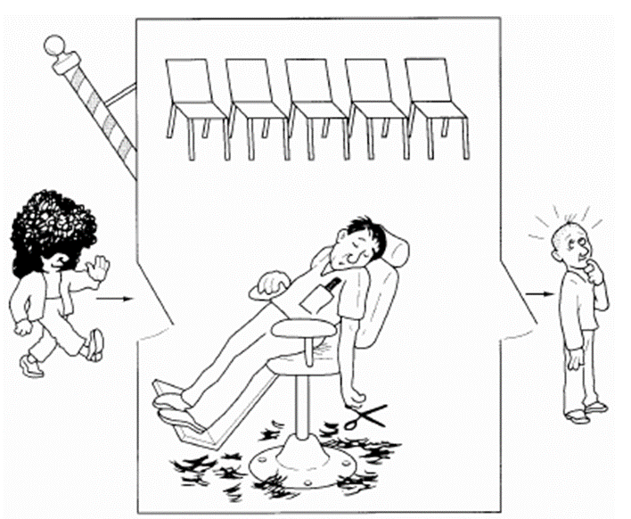
The Sleeping Barber Problem
We have a barber shop with one barber, one barber's chair, and a waiting room with n chairs.
If there are no customers, the barber sits in the barber's chair and sleeps.
When a customer arrives, the customer wakes up the barber and sits in the barber's chair, and the barber begins cutting the customer's hair.
If additional customers arrive while the barber is cutting hair, they sit down on chairs in the waiting room or, if the waiting room is full, they go away and don't come back.
Notes:
OSC7书中习题6.11

Slide 78
Definition
CHAIRS = 5
# Number of waiting room chairs
cust_sem = new_semaphore(0)
# Are customers waiting (& how many)?
barber_sem = new_semaphore(0)
# Are barbers waiting (& how many)?
wait_count = 0
# Number of customers waiting
wcc_sem = new_semaphore(1)
# Controls access to wait_count

Slide 79
def barber():
repeat_forever:
P(cust_sem) # Sleep, waiting for customers
P(wcc_sem) # Want exclusive on wait_count
wait_count = wait_count - 1 # One less customer waiting
V(barber_sem) # Barber is now ready to cut hair
V(wcc_sem) # Release exclusive on wait_count
cut_hair() # Cutting cutting cutting
def customer():
P(wcc_sem) # Want exclusive on wait_count
if wait_count < CHAIRS:
wait_count = wait_count + 1 # One more customer waiting
V(cust_sem) # Wake up barber if necessary
V(wcc_sem) # Release exclusive on wait_count
P(barber_sem) # Get haircut or sleep if no barber
get_haircut() # Sit down, bzzz bzzz, chop chop
else:
V(wcc_sem) # Shop is full; shrug and leave

Slide 80
6.7 Monitors (管程)
A high-level abstraction that provides a convenient and effective mechanism for process synchronization
Object-oriented method, simplify the synchronization procedure.
Only one process may be active within the monitor at a time(编译器保证过程操作的互斥性)
The process in the monitor may give up the occupation of monitor and waiting for accruing of some events and then resume running.

Slide 81
Monitors (管程)
monitor monitor_name
{
// shared variable declarations
procedure P1 (…) { …. }
…
procedure Pn (…) {……}
Initialization code ( ….) { … }
}

Slide 82
Why Monitors？
信号量及PV操作编程困难，充满了实现技巧，且代码分散在程序各处
因为对代码实现要求高，容易疏忽而发生编码错误，导致编写的程序功能失常，甚至发生死锁等错误
Brinch Hansen在1973年，Hoare在1974年，分别提出了一种新的同步机制：管程(Monitor)
管程是在程序设计语言中实现的成分
需要语言编译器支持管程机制(支持管程的语言包括Java，C#, Concurrent Pascal，Mesa等，但C/C++不支持管程)
Notes:
Mesa (programming language) History. Mesa was orig­i­nally de­signed in the Com­puter Sys­tems Lab­o­ra­tory (CSL), a branch of the Xerox Palo Alto Re­search Cen­ter, for the Alto, an ex­per­i­men­tal mi­cro-coded work­sta­tion.

Slide 83
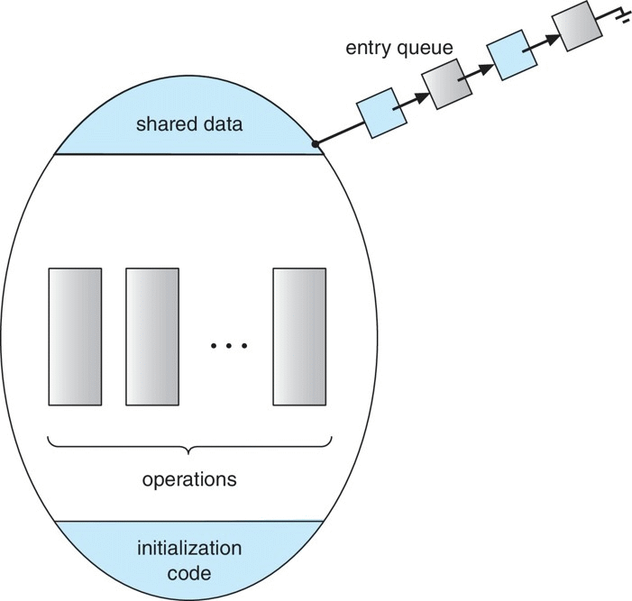
Schematic View of a Monitor
monitor_name
管程是特殊的模块
每个管程有一个名字
由关于共享资源的数据结构及在其上操作的一组过程组成
进程只能通过调用管程中的过程来间接地访问管程中的数据结构
Notes:
注：入口队列中的箭头方向是其数据结构中指针的方向，而非入口进程移动的方向

Slide 84
Condition Variables
condition x, y;
Condition is the waiting mechanism in the monitor. Each condition represent one waiting reason, and have a waiting queue
Two operations are allowed on a condition variable:
x.wait() – a process that invokes the operation is suspended until x.signal()
x.signal() – resumes one of processes (if any) that invoked x.wait()
If no x.wait() on the variable, then it has no effect on the variable
different from the signal operation of semaphore
Condition variables manage concurrent access of shared data

Slide 85
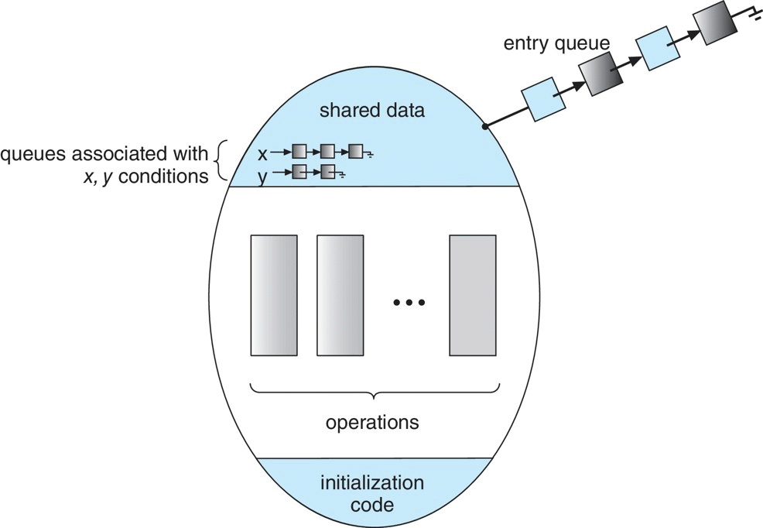
Monitor with Condition Variables
monitor_name
注：入口队列中的箭头方向是其数据结构中指针的方向，而非入口进程移动的方向

Slide 86
Usage of Condition Variable Example
Consider P₁ and P₂ that that need to execute two statements S₁ and S₂ and the requirement that S₁ to happen before S₂
Create a monitor with two procedures F₁ and F₂ that are invoked by P₁ and P₂ respectively
One condition variable “x”
One Boolean variable “done” initialized to false
F1:
S₁;
done = true;
x.signal();
F2:
if done = false
x.wait()
S₂;

Slide 87
Solution to Dining Philosophers
void test(int i) {
if((state[(i + 4) % 5] != EATING) \
&& (state[i] == HUNGRY) \
&& (state[(i + 1) % 5] != EATING)) {
state[i] = EATING;
self[i].signal();
}
}
initialization_code() {
for(int i = 0; i < 5; i++)
state[i] = THINKING;
}
} // end of monitor dp
monitor dp
{
enum {THINKING, HUNGRY, EATING} \
state[5];
condition self[5];
void pickup(int i) {
state[i] = HUNGRY;
test(i);
if(state[i] != EATING)
self[i].wait();
}
void putdown(int i) {
state[i] = THINKING;
//test left and right neighbors
test((i + 4) % 5); // - 1
test((i + 1) % 5);
}
3
3
2
4
2
4
1
0
1
0

Slide 88
Solution to Dining Philosophers (Cont.)
Each philosopher “i” invokes the operations pickup() and putdown() in the following sequence:
dp.pickup(i);
/** EAT **/
dp.putdown(i);
No deadlock, but starvation is possible

Slide 89
*Condition definition in Monitor for Producer-Consumer Problem
Class Conditon {
int numWaiting = 0;
WaitingQueue queue;
}
Condition :: Wait(lock) {
numWaiting++;
Add this process p to queue;
release(lock);
schedule(); // need mutex
require(lock);
}
Condition :: Signal() {
if(numWaiting > 0) {
remove a process p from queue;
wakeup(p); // need mutex
numWaiting--;
}
}

Slide 90
*Monitor Definition for P-C Problem
Class BoundedBuffer {
…
LOCK lock;
int count = 0;
Condition notFull, notEmpty;
}
BoundedBuffer :: Deposit(c) {
lock->acquire();
while(count == n)
notFull.wait(&lock);
add c to the buffer;
count++;
notEmpty.signal();
lock->release();
}
BoundedBuffer :: Remove(c) {
lock->acquire();
while(count == 0)
notEmpty.wait(&lock);
remove c from the buffer;
count--;
notFull.signal();
lock->release();
}

Slide 91
*Execution Priority After Condition Release
HANSEN scheme(OS, JAVA)
HOARE scheme(TEXTBOOK)
Lock ->Acquire ();
…
x.Wait()
Lock->Acquire();
…
x.Wait ()
P1 waiting…
P1 waiting…
P2 enter…
Lock->Acquire();
…
x.Signal();
…
Lock->release();
P2 enter…
Lock ->Acquire();
…
x.Signal();
P2 waiting…
P2 exit…
…
Lock ->release ();
P1 resume…
P1 exit…
…
Lock->release();
P1 resume…
P2 resume…
…
Lock->release();
P2 first
P1 first

Slide 92
*管程中进程相互唤醒的问题
当一个进入管程的进程执行等待操作时，它应当释放管程的互斥权
当后面进入管程的进程执行唤醒操作时，例如P唤醒Q，管程中便存在两个同时处于活动状态的进程
三种处理方法：
P等待，Q执行(Hoare管程)
Q等待(换为在紧急队列中等待)，P继续执行(Mesa管程)
规定唤醒操作为管程中最后一个可执行的操作(Hansen管程, Concurrent Pascal)

Slide 93
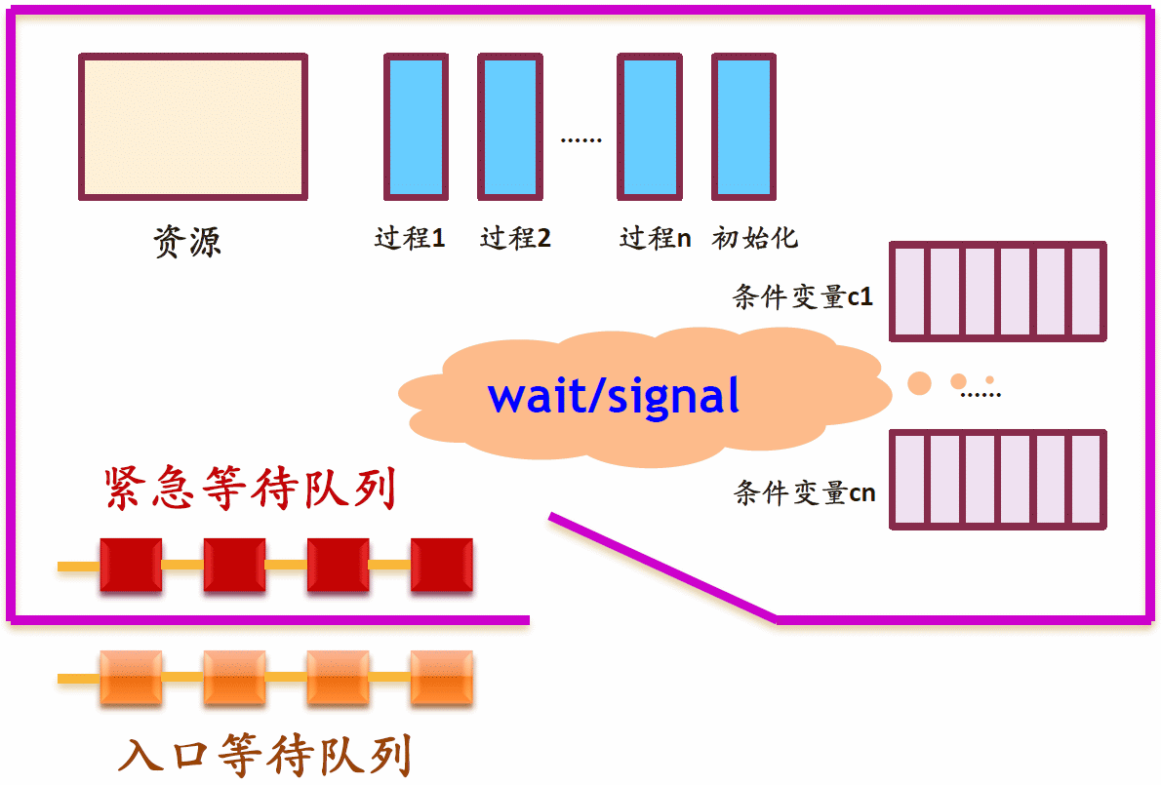
*Hoare管程示意图
Notes:
注：本图复制自北大陈向群老师的课件

Slide 94
Monitor Implementation Using Semaphores
Variables
semaphore mutex; // initially 1, for control entering monitor
semaphore next; // initially 0, signaling process suspend themselves
int next_count = 0;
Each procedure F will be replaced by(by compiler automatically):
wait(mutex);
…
body of F;
…
if (next_count > 0)
signal(next); // Let suspend process continue…
else
signal(mutex);
Mutual exclusion within a monitor is ensured by compiler
Notes:
注：这里的wait与signal为普通信号量的操作，而不是管程的wait/signal操作

Slide 95
*Monitor Implementation
For each condition variable x, we have:
semaphore x_sem; // initially 0
int x_count = 0;
The operation x.wait can be implemented as:
x-count++;
if (next_count > 0)
signal(next);
else
signal(mutex);
wait(x_sem);
x_count--;
The operation x.signal can be implemented as:
if (x_count > 0) {
next_count++;
signal(x_sem);
wait(next);
next_count--;
}

Slide 96
*6.8 Synchronization Examples
Solaris
Windows XP
Linux
Pthreads

Slide 97
Solaris Synchronization
Implements a variety of locks to support multitasking, multithreading (including real-time threads), and multiprocessing
Uses adaptive mutexes for efficiency when protecting data from short code segments
Uses condition variables and readers-writers locks when longer sections of code need access to data
Uses turnstiles(旋转门) to order the list of threads waiting to acquire either an adaptive mutex or reader-writer lock

Slide 98
Windows XP Synchronization
Uses interrupt masks to protect access to global resources on uniprocessor systems
Uses spinlocks on multiprocessor systems
Also provides dispatcher objects which may act as either mutexes and semaphores
Dispatcher objects may also provide events
An event acts much like a condition variable

Slide 99
Linux Synchronization
Linux:
disables interrupts to implement short critical sections
Linux provides:
semaphores
spin locks

Slide 100
Pthreads Synchronization
Pthreads API is OS-independent
It provides:
mutex locks
condition variables
Non-portable extensions include:
read-write locks
spin locks

Slide 101
*6.9 Atomic Transactions(原子事务)
System Model
Log-based Recovery
Checkpoints
Concurrent Atomic Transactions

Slide 102
System Model
Assure that operations happen as a single logical unit of work, in its entirety, or not at all
Related to field of database systems
Challenge is assuring atomicity despite computer system failures
Transaction - collection of instructions or operations that performs single logical function
Here we are concerned with changes to stable storage – disk
Transaction is series of read and write operations
Terminated by commit (transaction successful) or abort (transaction failed) operation
Aborted transaction must be rolled back to undo any changes it performed

Slide 103
Types of Storage Media
Volatile storage – information stored here does not survive system crashes
Example: main memory, cache
Nonvolatile storage – Information usually survives crashes
Example: disk and tape
Stable storage – Information never lost
Not actually possible, so approximated via replication or RAID to devices with independent failure modes
Goal is to assure transaction atomicity where failures cause loss of information on volatile storage

Slide 104
Log-Based Recovery
Record to stable storage information about all modifications by a transaction
Most common is write-ahead logging
Log on stable storage, each log record describes single transaction write operation, including
Transaction name
Data item name
Old value
New value
<T_{i} starts> written to log when transaction T_{i} starts
<T_{i} commits> written when T_{i} commits
Log entry must reach stable storage before operation on data occurs

Slide 105
Log-Based Recovery Algorithm
Using the log, system can handle any volatile memory errors
Undo(T_{i}) restores value of all data updated by T_{i}
Redo(T_{i}) sets values of all data in transaction T_{i} to new values
Undo(T_{i}) and redo(T_{i}) must be idempotent
Multiple executions must have the same result as one execution
If system fails, restore state of all updated data via log
If log contains <T_{i} starts> without <T_{i} commits>, undo(T_{i})
If log contains <T_{i} starts> and <T_{i} commits>, redo(T_{i})

Slide 106
Checkpoints
Log could become long, and recovery could take long
Checkpoints shorten log and recovery time.
Checkpoint scheme:
Output all log records currently in volatile storage to stable storage
Output all modified data from volatile to stable storage
Output a log record <checkpoint> to the log on stable storage
Now recovery only includes Ti, such that Ti started executing before the most recent checkpoint, and all transactions after Ti All other transactions already on stable storage

Slide 107
Concurrent Transactions
Must be equivalent to serial execution – serializability
Could perform all transactions in critical section
Inefficient, too restrictive
Concurrency-control algorithms provide serializability

Slide 108
Serializability
Consider two data items A and B
Consider Transactions T₀ and T₁
Execute T₀, T₁ atomically
Execution sequence called schedule
Atomically executed transaction order called serial schedule
For N transactions, there are N! valid serial schedules

Slide 109
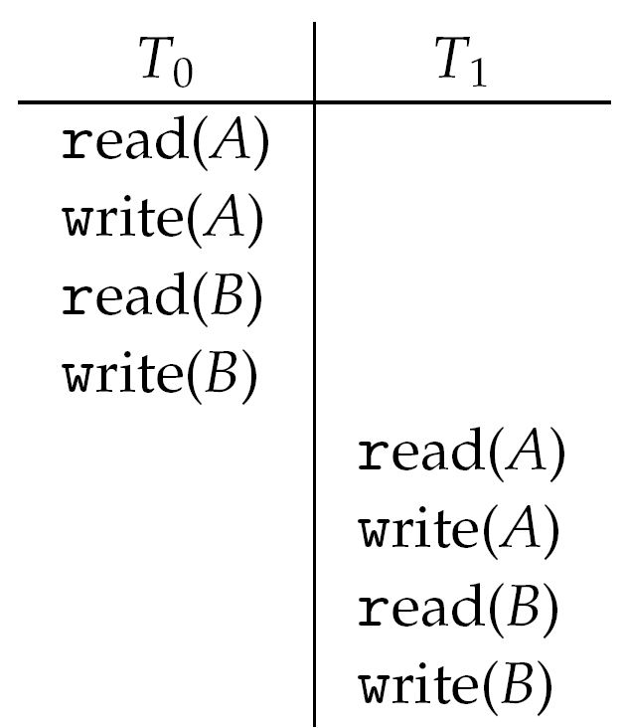
Schedule 1: T₀ then T₁

Slide 110
Nonserial Schedule
Nonserial schedule allows overlapped execute
Resulting execution not necessarily incorrect
Consider schedule S, operations O_{i}, O_{j}
Conflict if access same data item, with at least one write
If O_{i}, O_{j} consecutive operations of different transactions && O_{i} and O_{j} don’t conflict
Then S’ with swapped order O_{j} O_{i} equivalent to S
If S can become serial schedule S’ via swapping nonconflicting operations
S is conflict serializable

Slide 111
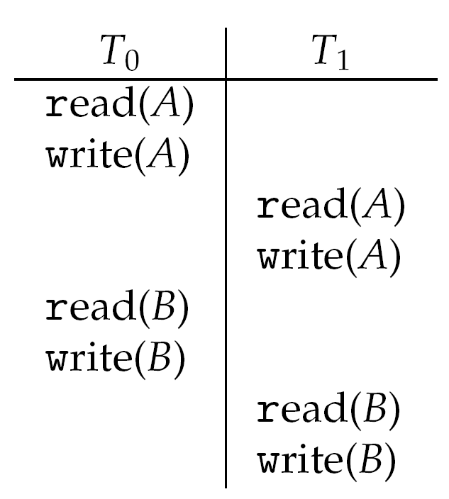
Schedule 2: Concurrent Serializable Schedule

Slide 112
Locking Protocol
Ensure serializability by associating lock with each data item
Follow locking protocol for access control
Locks
Shared – T_{i} has shared-mode lock (S) on item Q, T_{i} can read Q but not write Q
Exclusive – T_{i} has exclusive-mode lock (X) on Q, T_{i} can read and write Q
Require every transaction on item Q acquire appropriate lock
If lock already held, new request may have to wait
Similar to readers-writers algorithm

Slide 113
Two-phase Locking Protocol
Each transaction issues lock and unlock requests in two phases
Growing – obtaining locks
Shrinking – releasing locks
Generally ensures conflict serializability
Does not prevent deadlock

Slide 114
Timestamp-based Protocols
Select order among transactions in advance – timestamp-ordering
Transaction T_{i} associated with timestamp TS(T_{i}) before T_{i} starts
TS(T_{i}) < TS(T_{j}) if Ti entered system before T_{j}
TS can be generated from system clock or as logical counter incremented at each entry of transaction
Timestamps determine serializability order
If TS(T_{i}) < TS(T_{j}), system must ensure produced schedule equivalent to serial schedule where T_{i} appears before T_{j}

Slide 115
Timestamp-based Protocol Implementation
Data item Q gets two timestamps
W-timestamp(Q) – largest timestamp of any transaction that executed write(Q) successfully
R-timestamp(Q) – largest timestamp of successful read(Q)
Updated whenever read(Q) or write(Q) executed
Timestamp-ordering protocol assures any conflicting read and write executed in timestamp order
Suppose Ti executes read(Q)
If TS(T_{i}) < W-timestamp(Q), Ti needs to read value of Q that was already overwritten
read operation rejected and T_{i} rolled back
If TS(T_{i}) ≥ W-timestamp(Q)
read executed, R-timestamp(Q) set to max(R-timestamp(Q), TS(T_{i}))

Slide 116
Timestamp-ordering Protocol
Suppose Ti executes write(Q)
If TS(T_{i}) < R-timestamp(Q), value Q produced by T_{i} was needed previously and T_{i} assumed it would never be produced
Write operation rejected, T_{i} rolled back
If TS(T_{i}) < W-timestamp(Q), T_{i} attempting to write obsolete value of Q
Write operation rejected and T_{i} rolled back
Otherwise, write executed
Any rolled back transaction T_{i} is assigned new timestamp and restarted
Algorithm ensures conflict serializability and freedom from deadlock

Slide 117
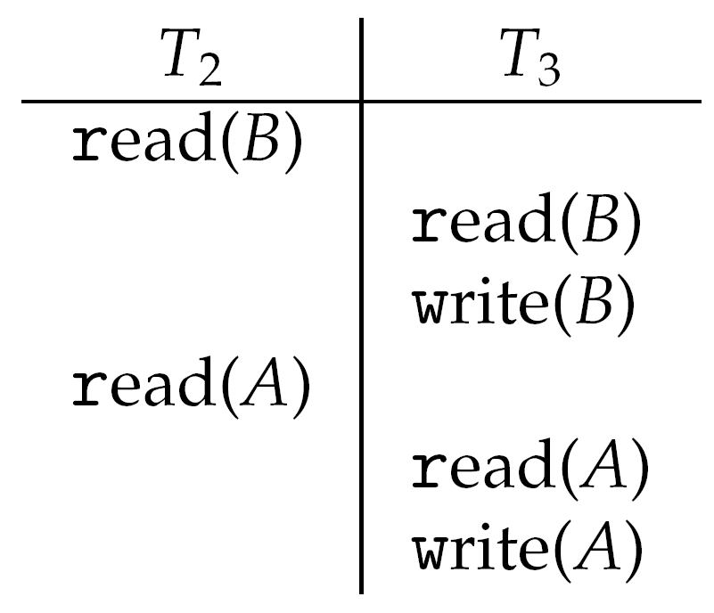
Schedule Possible Under Timestamp Protocol

Slide 118
Timestamp-ordering Protocol
Problem with timestamp-ordering protocol:
Suppose T_{i} aborts, but T_{j} has read a data item written by T_{i}
Then T_{j} must abort; if T_{j} had been allowed to commit earlier, the schedule is not recoverable.
Further, any transaction that has read a data item written by T_{j} must abort
This can lead to cascading rollback --- that is, a chain of rollbacks
Solution:
A transaction is structured such that its writes are all performed at the end of its processing
All writes of a transaction form an atomic action; no transaction may execute while a transaction is being written
A transaction that aborts is restarted with a new timestamp

Slide 119
Summary 1/6
A race condition occurs when processes have concurrent access to shared data and the final result depends on the particular order in which concurrent accesses occur. Race conditions can result in corrupted values of shared data.
A critical section is a section of code where shared data may be manipulated and a possible race condition may occur. The critical-section problem is to design a protocol whereby processes can synchronize their activity to cooperatively share data.

Slide 120
Summary 2/6
A solution to the critical-section problem must satisfy the following three requirements: (1) mutual exclusion, (2) progress, and (3) bounded waiting. Mutual exclusion ensures that only one process at a time is active in its critical section. Progress ensures that programs will cooperatively determine what process will next enter its critical section. Bounded waiting limits how much time a program will wait before it can enter its critical section.
Software solutions to the critical-section problem, such as Peterson’s solution, do not work well on modern computer architectures.

Slide 121
Summary 3/6
Hardware support for the critical-section problem includes memory barriers; hardware instructions, such as the test-and-set instruction; and atomic variables.
A mutex lock provides mutual exclusion by requiring that a process acquire a lock before entering a critical section and release the lock on exiting the critical section.
Semaphores, like mutex locks, can be used to provide mutual exclusion. However, where as a mutex lock has a binary value that indicates if the lock is available or not, a semaphore has an integer value and can therefore be used to solve a variety of synchronization problems.

Slide 122
Summary 4/6
A monitor is an abstract data type that provides a high-level form of process synchronization. A monitor uses condition variables that allow processes to wait for certain conditions to become true and to signal one another when conditions have been set to true.
Solutions to the critical-section problem may suffer from liveness problems, including deadlock.

Slide 123
Summary 5/6
Classic problems of process synchronization include the bounded-buffer, readers–writers, and dining-philosophers problems. Solutions to these problems can be developed using the tools presented in this chapter, including mutex locks, semaphores, monitors, and condition variables.
Windows uses dispatcher objects as well as events to implement process synchronization tools.
Linux uses a variety of approaches to protect against race conditions, including atomic variables, spinlocks, and mutex locks.

Slide 124
Summary 6/6
The POSIX API provides mutex locks, semaphores, and condition variables. POSIX provides two forms of semaphores: named and unnamed. Several unrelated processes can easily access the same named semaphore by simply referring to its name. Unnamed semaphores cannot be shared as easily, and require placing the semaphore in a region of shared memory.
Java has a rich library and API for synchronization. Available tools include monitors (which are provided at the language level) as well as reentrant locks, semaphores, and condition variables (which are supported by the API).

Slide 125
End of Chapter 6: Process Synchronization

